Slide 1
Science and Engineering Fair
Grades 4-6

Slide 2
Why is the Science and Engineering Fair so important?
Hands on science is proven to help students be better critical thinkers and problem solvers! The skills learned by participating in the Science and Engineering Fair also helps to improve students understanding of the Nature of Science skills!

Slide 3
Science and Engineering Fair Categories
Science
Physics and Astronomy
Plant Science
Animal Science
Chemistry
Microbiology
Earth and Environmental Sciences
Human Behavioral Science

Slide 4
Science and Engineering Categories cont.
Engineering:
Engineering Mechanics
Environmental Engineering
Mathematics and Computer Science:
Coding
Mathematics
Robotics and Intelligent Machines

Slide 5
How to do a "Science Fair Project"
Brainstorm Ideas
Come up with 3 problems or ideas, questions
Research
Form a Hypothesis
Make your plan- Materials, Procedures, "what are your variables?"
Record Data
Write results and conclusion
Display your information on the board.

Slide 6
Science Fair Timeline
Due Dates | Assignment | Possible Points | Points earned
9/25/24 | 3 project ideas | 10
10/2/24 | Final project choice and approval forms | 10
10/16/24 | Research, Bibliography and Hypothesis | 10
10/23/24 | Materials, Procedures and Variables | 15
12/4/24 | Data check | 15
12/18/24 | Results and Conclusion | 10
1/8/25 | Completed logbook and board | 30
 | TOTAL | 100

Slide 7
Important Reminders
You may work in teams of two students in grade 4-6 who attend Turner
Projects must have AT LEAST 3 trials when testing in order to get a Regional bid
Projects MUST have a handwritten log book in order to get a Regional bid
Projects MUST have a presentation board in order to get a Regional bid
Projects MUST have a bibliography in the log book in order to get a Regional bid
Projects where mold is grown are not allowed and will be disqualified
Projects involving harm to living things are not allowed and will be disqualified
Projects that deal with the Indian River Lagoon may be judged for special awards

Slide 8
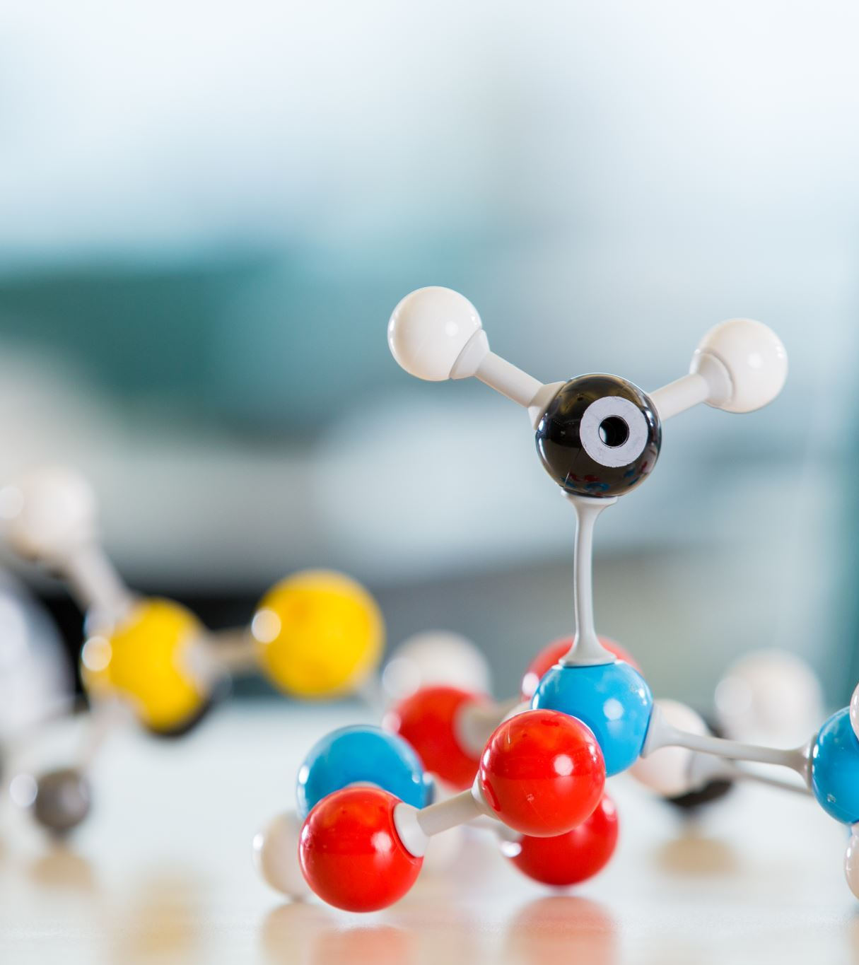
Forms, Checklists and Timelines
School Fair: January 22nd, 2025
Regional Fair and Awards: March 13th, 2025
The student handbook can be found on Turner's website, Turner's Facebook and BPS website. Students will also get a shorter version of the handbook and needed forms from their teacher in the next couple of weeks.

Slide 9
Questions?
Contact your student’s classroom teacher or school science coach.....

